Slide 1

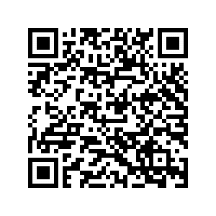

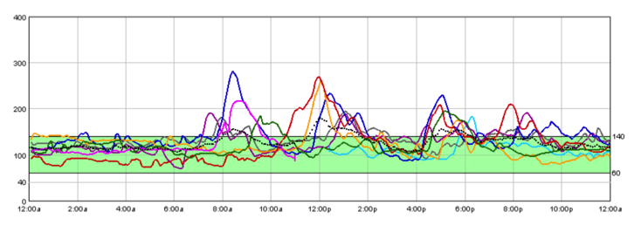
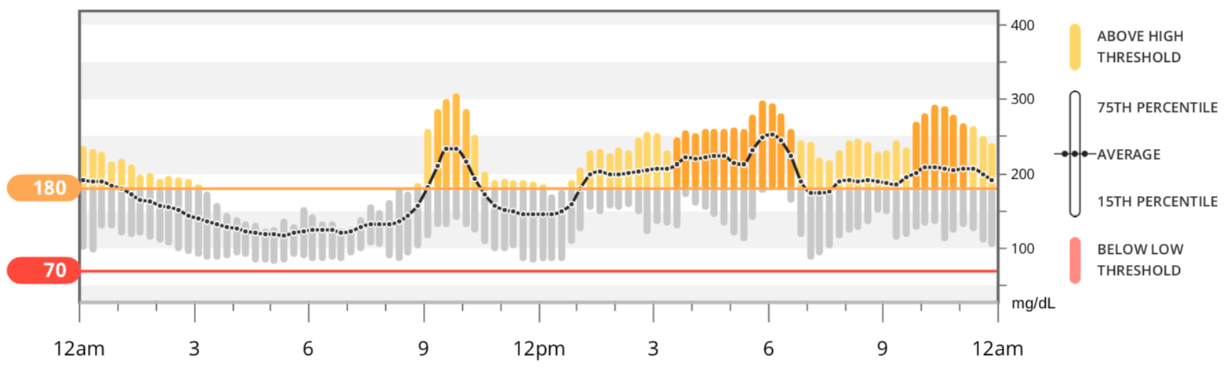
An R Package for Analysis of
Continuous Glucose Monitor Data
Tim Vigers^{1,2,3}, Christine L. Chan¹, Janet Snell-Bergeon², Petter Bjørnstad¹,
Philip S. Zeitler¹, Gregory Forlenza², Laura Pyle^{1,2,3}
Department of Pediatric Endocrinology, University of Colorado School of Medicine, Aurora, Colorado, United States
Barbara Davis Center, Aurora, Colorado, United States
Department of Biostatistics and Informatics, Colorado School of Public Health
Objective
To develop a standardized, free, open-source method for data management and analysis of continuous glucose monitor (CGM) data.
Calculate the key metrics recommended in the International Consensus on Use of Continuous Glucose Monitoring.
Provide graphical tools similar to the Ambulatory Glucose Profile (AGP).
Methods
We wrote a package in the freely available statistical programming language R (R Foundation for Statistical Computing, Vienna, Austria).
Summary variables and aggregate daily overlays were compared to proprietary CGM software (only one device shown here).
Proprietary software does not calculate MAGE or other more complex variables, so these were not compared.
cgmanalysis vs. iPro 2
cgmanalysis vs. Dexcom Clarity
 | cgmanalysis | iPro
# Sensor Values | 2000 | 2000
Highest | 282 | 282
Lowest | 70 | 70
Average | 126.87 | 127
Standard Dev | 30.79 | 31
# High Excursions | 31 | 32
# Low Excursions | 0 | 0
% Time Above 140 | 24.85 | 24
% Time Below 60 | 0 | 0
 | cgmanalysis | Dexcom Clarity
Average | 175.679 | 176
Standard Dev | 67.097 | 68
Time in Range | 55.657 | 56
Results
Summary variables calculated by our package compare well to those generated by various CGM software.
Our functions increase the number and complexity of summary measures readily available to clinicians and researchers.
Calculated Variables
Percent CGM wear
Average sensor glucose
Sensor glucose standard deviation
Sensor glucose coefficient of variation
Minimum sensor glucose
Maximum sensor glucose
Sensor glucose quartiles
Variables above for daytime and nighttime periods
Estimated A1c (eA1c)
Glucose management indicator (GMI)
Excursions, minutes and % time above/below threshold
Minutes and % time in range (70 – 180 mg/dL)
Area under the curve (trapezoidal rule)
Mean amplitude of glycemic excursions (MAGE)
J index
Continuous overall net glycemic action (CONGA)
Mean of daily differences (MODD)
Low blood glucose index (LBGI)
High blood glucose index (HBGI)
Conclusions
Consistent handling of CGM data using our R package will allow for collaboration between research groups and contribute to a better understanding of free-living glucose patterns.

